Slide 1

Design and Development of Cyclorotor for Parametric Study of Thrust Vectoring
FYP BME-075
TRIBHUVAN UNIVERSITY
INSTITUTE OF ENGINEERING
THAPATHALI CAMPUS
Department of Automobile and Mechanical Engineering
Presentation on
Abhishek Kandel (THA075BME003)
Milan Dhami (THA075BME019)
Ringjing Tamang (THA075BME030)
Rohit Pati (THA075BME031)
Supervisor - Er.Biman Rimal

Slide 2
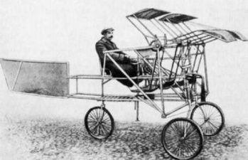
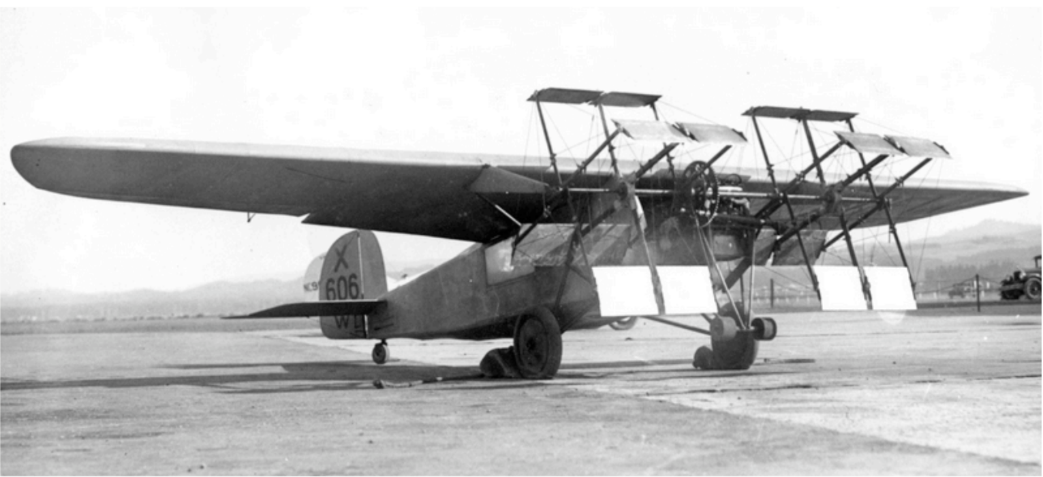
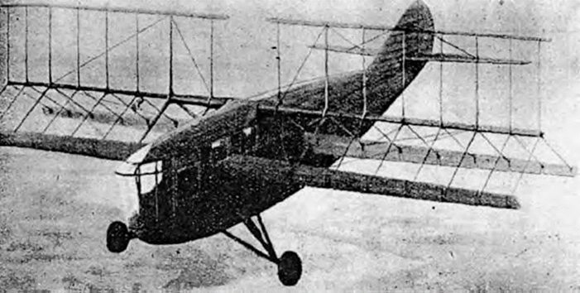
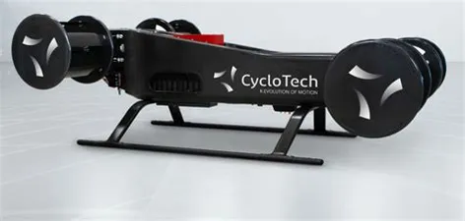
Introduction
FYP BME-075
Schroeder Cyclogyro, 1930
Sverchkov's Samoljot, St-Peterburg, 1909 (Bowers)
Rohrbach's Cyclogyro, 1933 (Arndt)
CycloTech Gmbh, 2021
Notes:
In 1933, experiments in Germany by Adolf Rohrbach resulted in a paddle-wheel wing arrangement.
Oscillating winglets went from positive to negative angles of attack during each revolution to create lift
Their eccentric mounting would, in theory, produce nearly any combination of horizontal and vertical (Arndt) forces
But the foreign aviation journals of the time casted doubt on the soundness of the design which meant that funding for the project could not be raised.

Slide 3
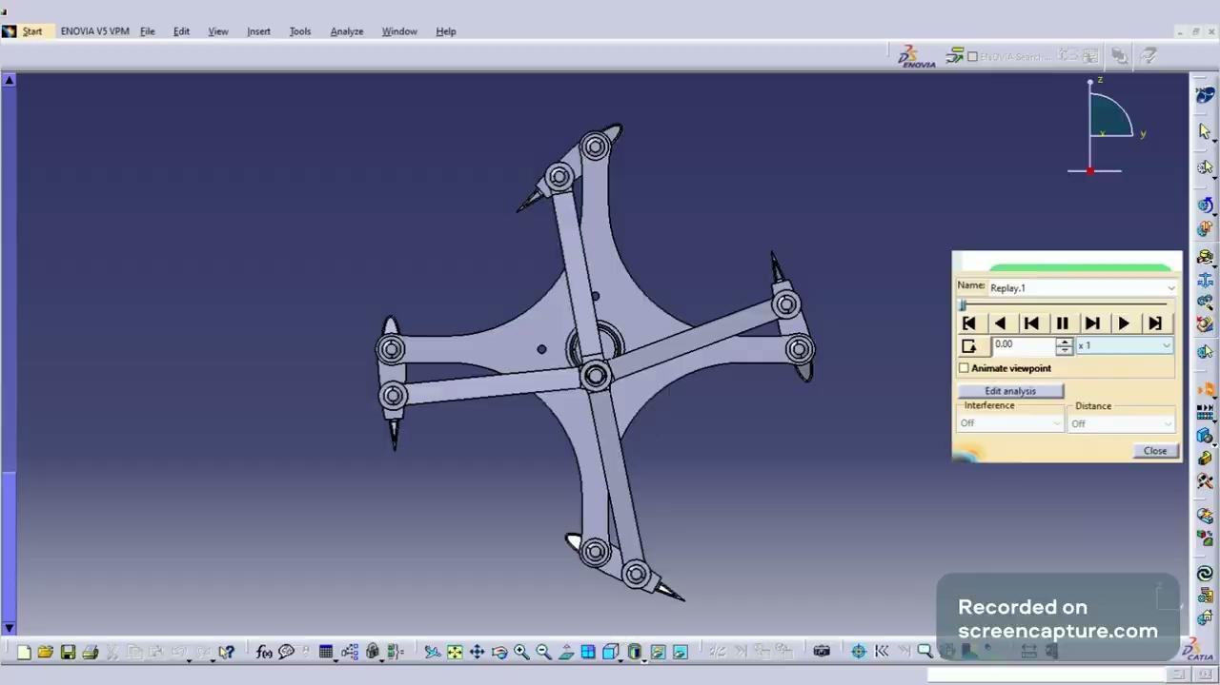
Introduction
FYP BME-075

Slide 4
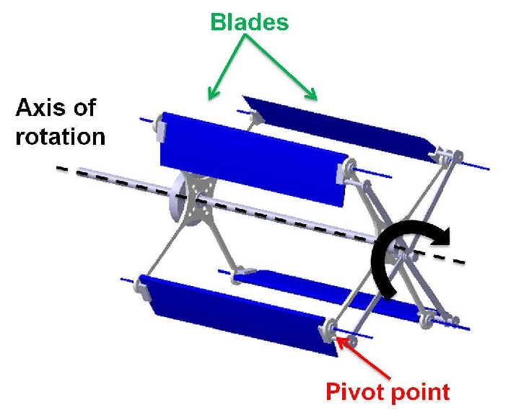
Introduction
FYP BME-075
Cyclorotor (Shrestha, Benedict and Hrishikeshavan)

Slide 5
Objectives
FYP BME-075
MAIN OBJECTIVE
To build and study the thrust vectoring pattern in cyclorotor.
SPECIFIC OBJECTIVES
To design and build a viable cyclorotor.
To design and build a reliable thrust test rig.
To conduct a parametric study on thrust vector of the cyclorotor.

Slide 6
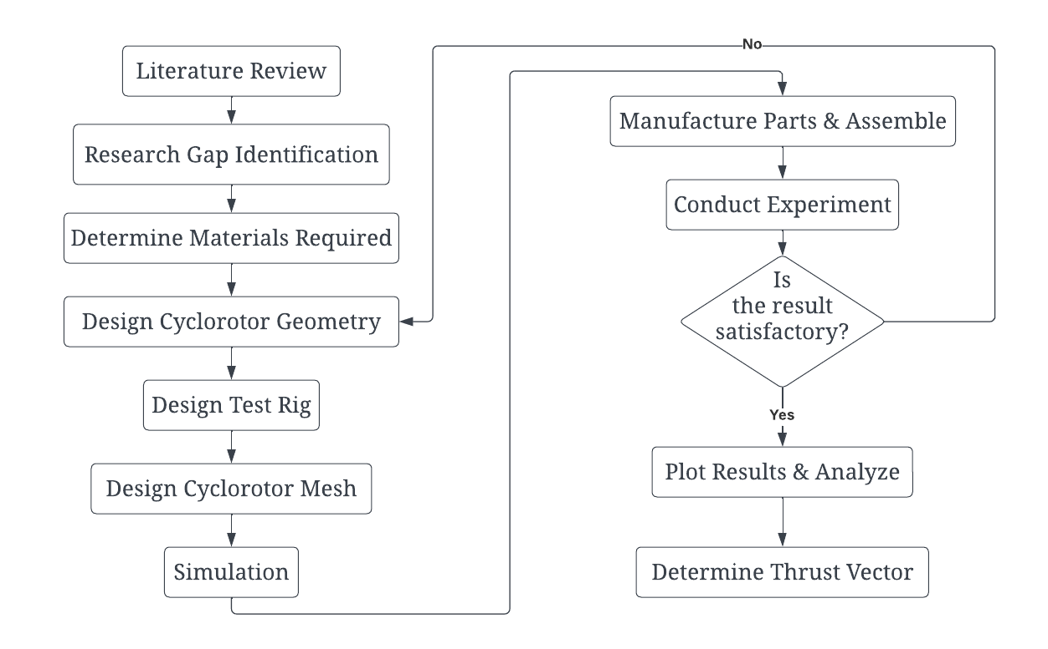
Methodology
FYP BME-075
Notes:
Thrust determination using Testing Rig Parts to be manufactured by 3D Printing URANS Solver ANSYS Fluent for CFD Simulation

Slide 7
3. Methodology
FYP BME-075
ASSUMPTIONS
Negligible bending in the blades.
Flow around the cyclorotor is uniform.
The obstruction in airflow caused by the rotor’s lift non-generating parts is neglected.
Notes:
Thrust determination using Testing Rig Parts to be manufactured by 3D Printing URANS Solver ANSYS Fluent for CFD Simulation

Slide 8
4. Cyclorotor Design
FYP BME-075
Key considerations:
Blade geometry
Drive system
Control system
Structure
Aerodynamics
Notes:
Thrust determination using Testing Rig Parts to be manufactured by 3D Printing URANS Solver ANSYS Fluent for CFD Simulation

Slide 9
4. Cyclorotor Design
Design parameter
FYP BME-075
Airfoil NACA 0015
Rotor diameter 152.4 mm
Total blade span 171 mm
Chord Length 50.8 mm
Pitching axis location 25% of chord from leading edge
Actuation point 17.5 mm from Pitching axis
Total length of control rod 76.2 mm
Carbon Rod Spar 4 mm (diameter)
Notes:
Thrust determination using Testing Rig Parts to be manufactured by 3D Printing URANS Solver ANSYS Fluent for CFD Simulation

Slide 10
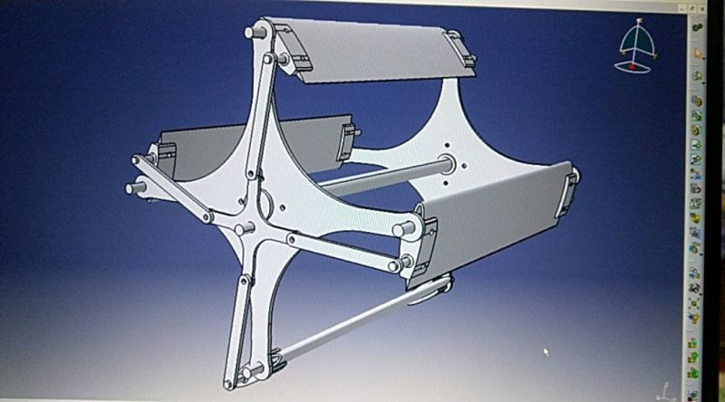
4. Cyclorotor Design
FYP BME-075
Cyclorotor 3D Model
Notes:
Thrust determination using Testing Rig Parts to be manufactured by 3D Printing URANS Solver ANSYS Fluent for CFD Simulation

Slide 11
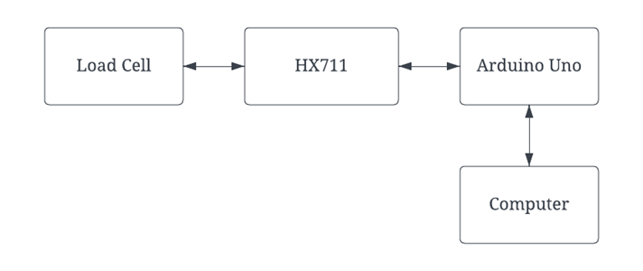
5. Test Rig Design
FYP BME-075
System Architecture of Test Rig
Notes:
Thrust determination using Testing Rig Parts to be manufactured by 3D Printing URANS Solver ANSYS Fluent for CFD Simulation

Slide 12
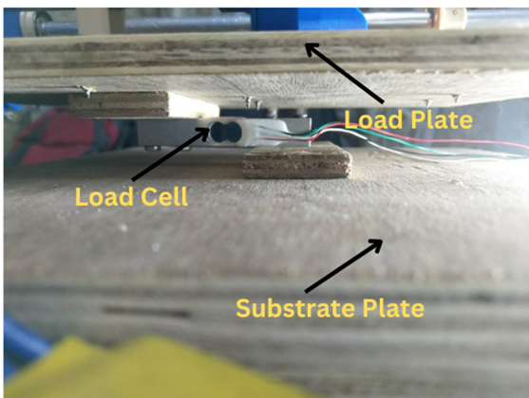
5. Test Rig Design
FYP BME-075
Test Rig
Notes:
Thrust determination using Testing Rig Parts to be manufactured by 3D Printing URANS Solver ANSYS Fluent for CFD Simulation

Slide 13
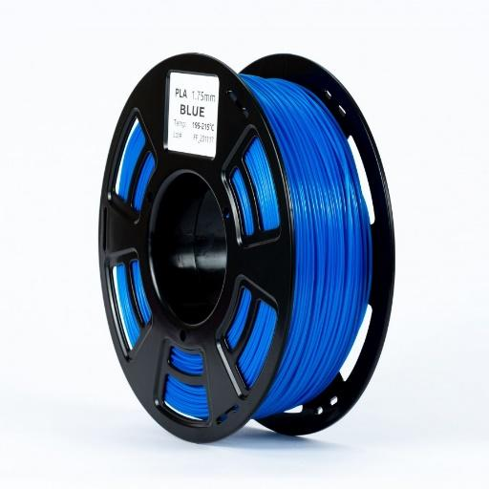
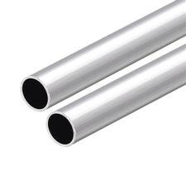
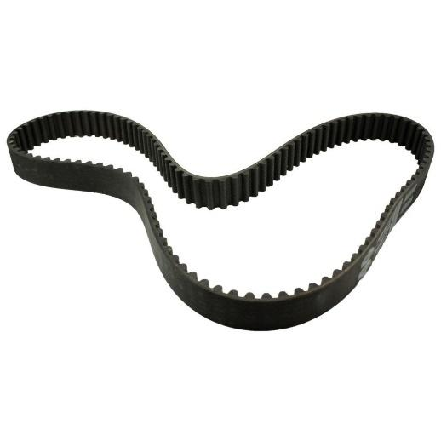
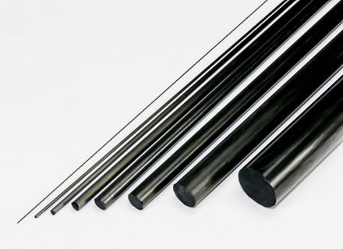
6. Material and Components Selection
FYP BME-075
Aluminum Tubes
PLA Filament
GT Timing Belt 6mm width
Carbon Fiber
Notes:
Thrust determination using Testing Rig Parts to be manufactured by 3D Printing URANS Solver ANSYS Fluent for CFD Simulation

Slide 14
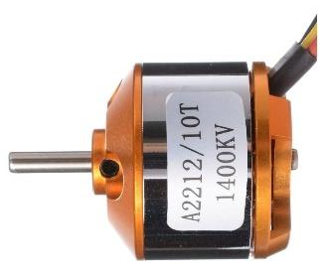
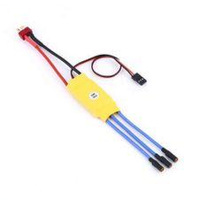
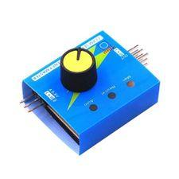
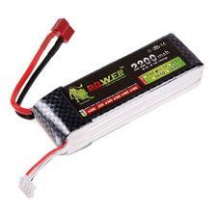
6. Material and Components Selection
FYP BME-075
Brushless DC Motor
ESC (Electronic Speed Controller)
LiPo Battery 2200 mAh
Servo Tester
Notes:
Thrust determination using Testing Rig Parts to be manufactured by 3D Printing URANS Solver ANSYS Fluent for CFD Simulation

Slide 15
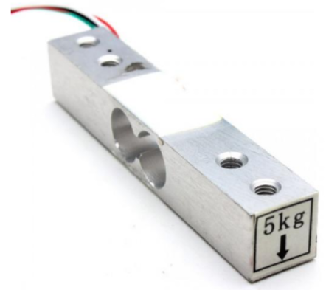
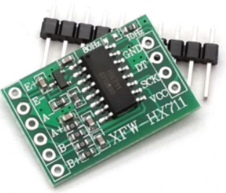
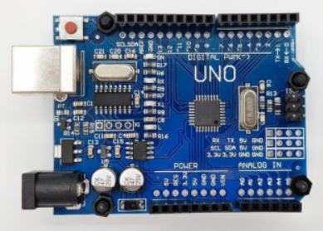
6. Material and Components Selection
FYP BME-075
HX711 Amplifier
Load Cell
Arduino Uno
Notes:
Thrust determination using Testing Rig Parts to be manufactured by 3D Printing URANS Solver ANSYS Fluent for CFD Simulation

Slide 16
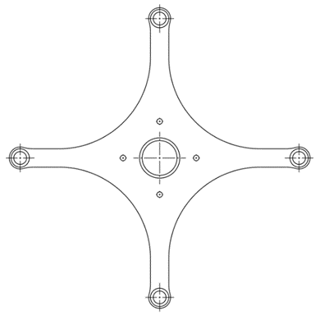
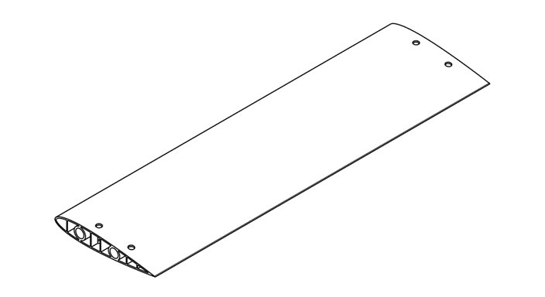
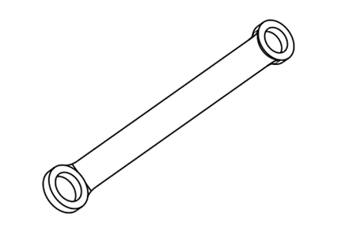
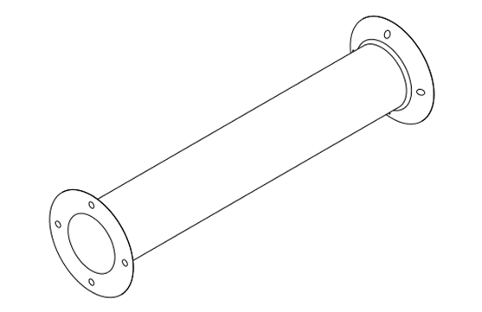
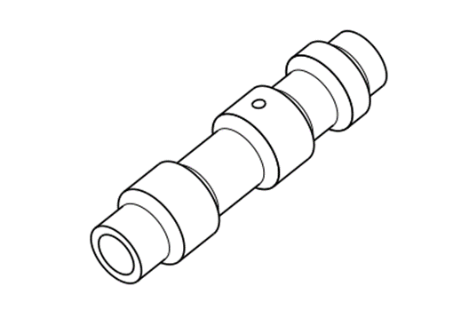
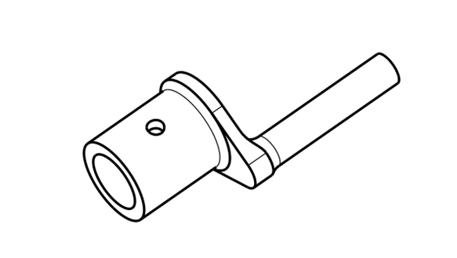
7. Fabrication and Assembly
FYP BME-075
NACA 0015 Airfoil Blade
Main Rotor Wheel
Control Rod
Servo Coupler (Inboard)
Servo Coupler (Outboard)
Main Separator Shaft
Notes:
Thrust determination using Testing Rig Parts to be manufactured by 3D Printing URANS Solver ANSYS Fluent for CFD Simulation

Slide 17
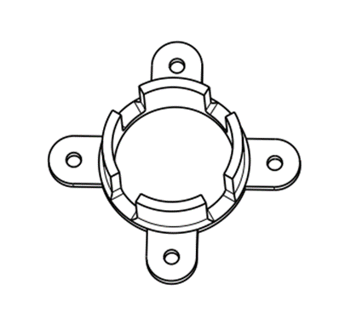
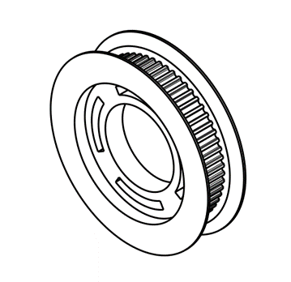
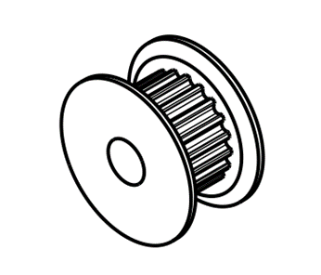
7. Fabrication and Assembly
FYP BME-075
Pulley Coupler
GT2 Timing Pulley 20 Teeth
GT2 Timing Pulley 60 Teeth
Notes:
Thrust determination using Testing Rig Parts to be manufactured by 3D Printing URANS Solver ANSYS Fluent for CFD Simulation

Slide 18
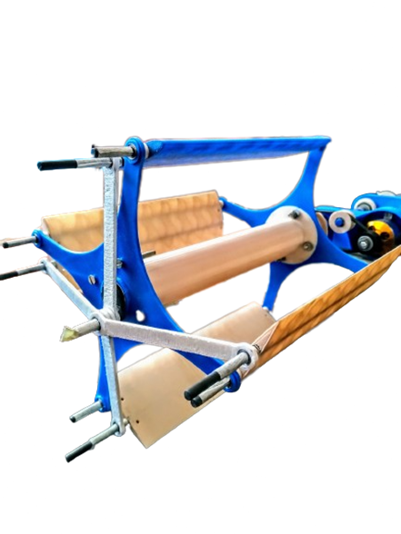
7. Fabrication and Assembly
FYP BME-075
Assembled Model of Cyclorotor
Notes:
Thrust determination using Testing Rig Parts to be manufactured by 3D Printing URANS Solver ANSYS Fluent for CFD Simulation

Slide 19
8. Simulation of Cyclorotor
Simulation
FYP BME-075
8 simulations were done at different pitching angle.
Software OpenFOAM
Solver PimpleFOAM
Initial conditions:
Flow velocity (0,0,0)
Kinematic pressure 0
RPM 1400
Center of rotation (pitching motion) (0.1,0,0)
Notes:
Thrust determination using Testing Rig Parts to be manufactured by 3D Printing URANS Solver ANSYS Fluent for CFD Simulation

Slide 20
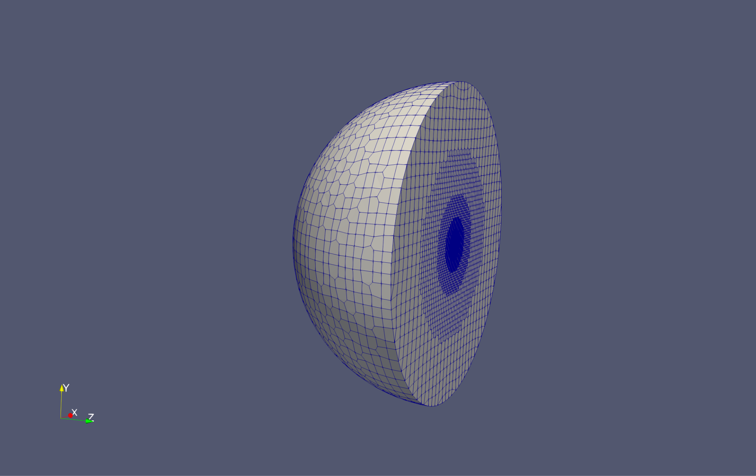
8. Simulation of Cyclorotor
Mesh Generation
FYP BME-075
The mesh is refined with different refined spheres.
SnappyHexMesh was used for mesh generation
AMI were used for rotating mesh
Notes:
Thrust determination using Testing Rig Parts to be manufactured by 3D Printing URANS Solver ANSYS Fluent for CFD Simulation

Slide 21
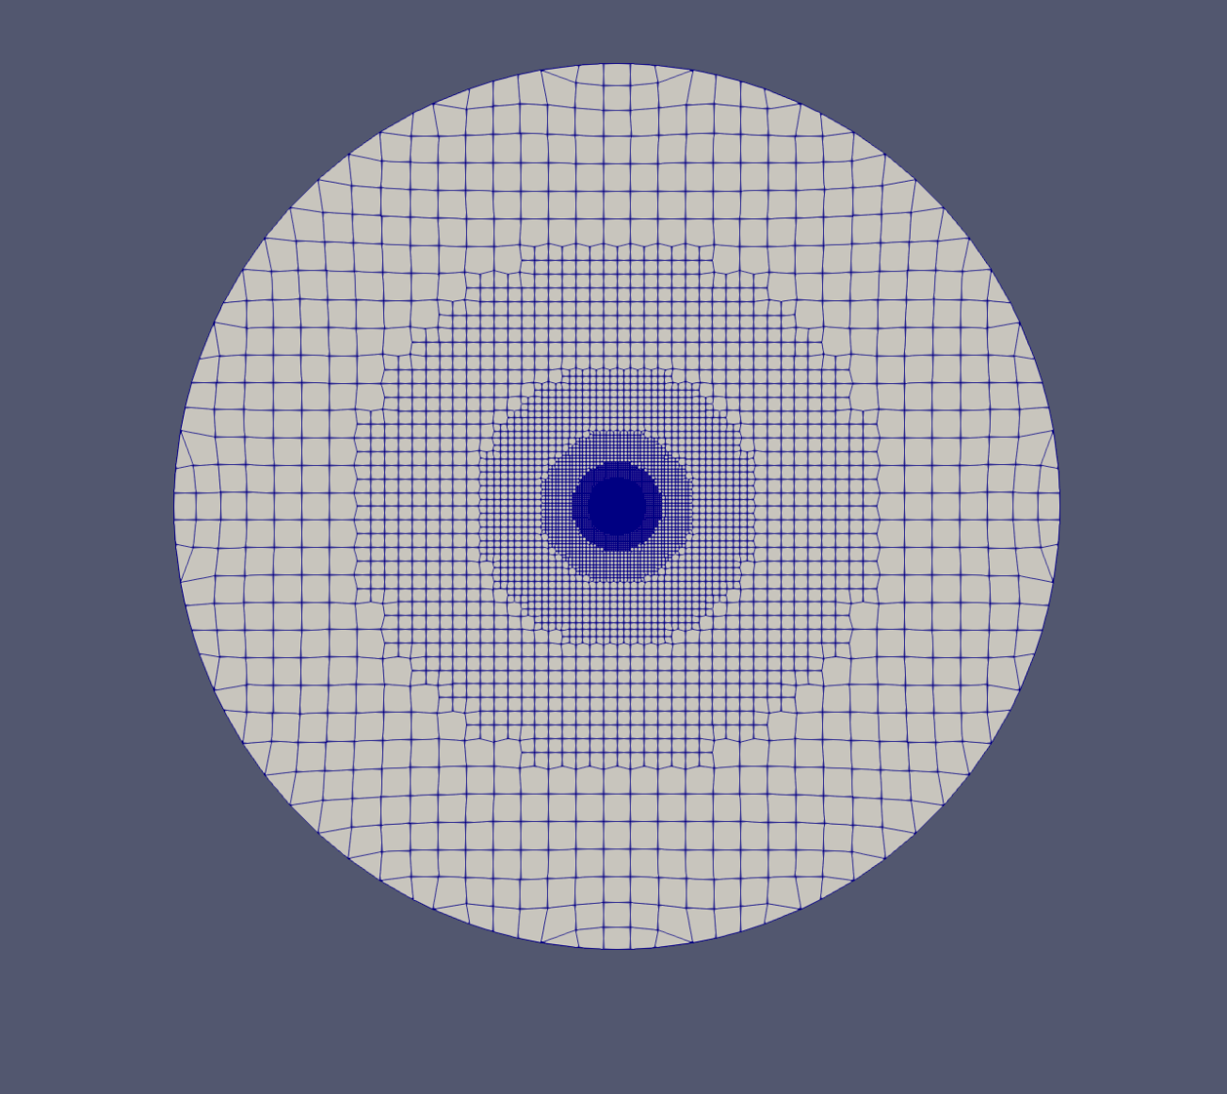
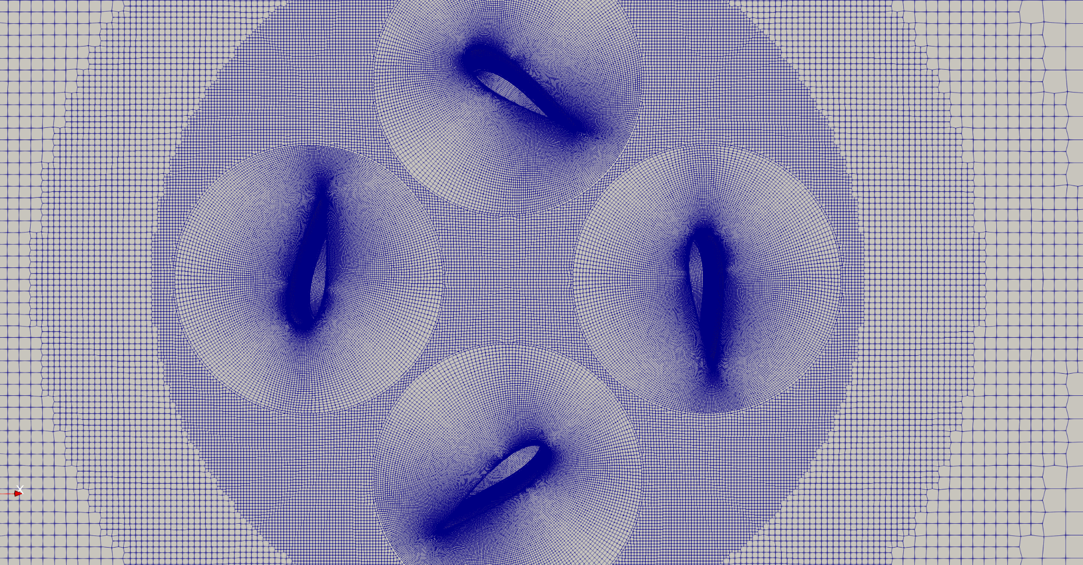
8. Simulation of Cyclorotor
Mesh Generation
FYP BME-075
Magnified View of Mesh
Fig : Refined Mesh
Notes:
Thrust determination using Testing Rig Parts to be manufactured by 3D Printing URANS Solver ANSYS Fluent for CFD Simulation

Slide 22
8. Simulation of Cyclorotor
Post Processing
FYP BME-075
Extracting the surface from the mesh.
Generating surface normal.
The lift is obtained by multiplying the surface normal with the pressure.
Notes:
Thrust determination using Testing Rig Parts to be manufactured by 3D Printing URANS Solver ANSYS Fluent for CFD Simulation

Slide 23
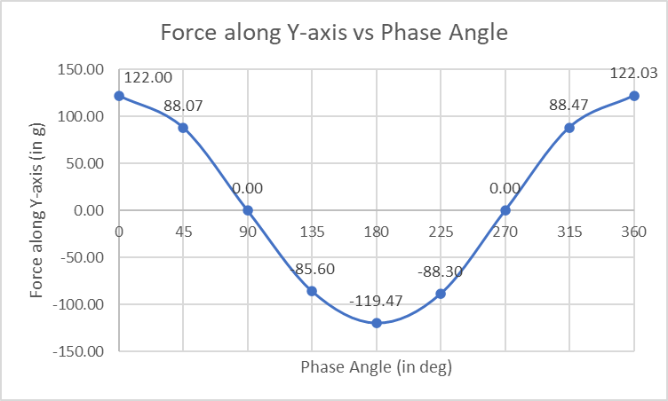
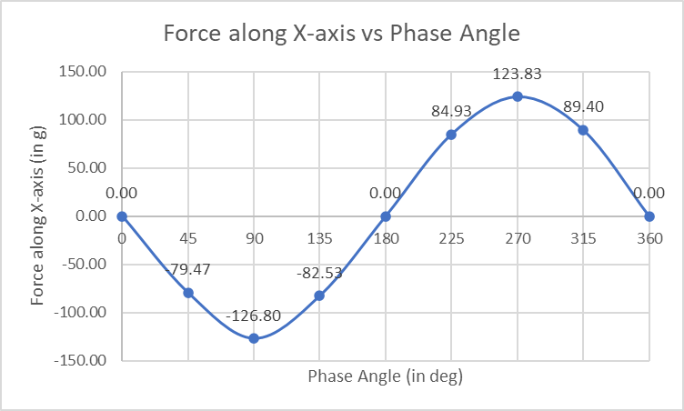
8. Simulation of Cyclorotor
Simulation results
FYP BME-075

Slide 24
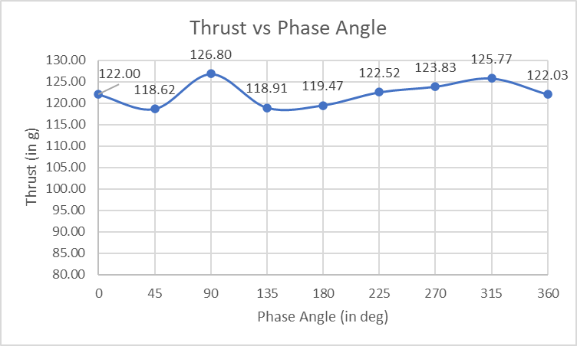
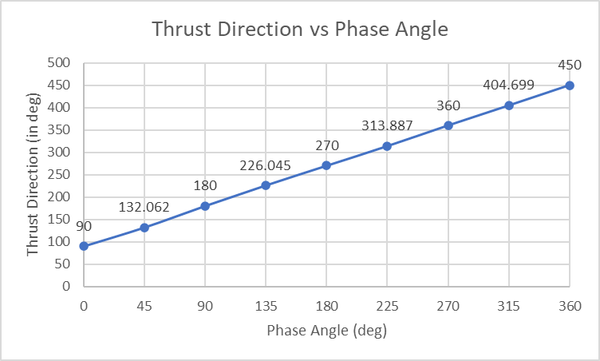
8. Simulation of Cyclorotor
Simulation results
FYP BME-075

Slide 25
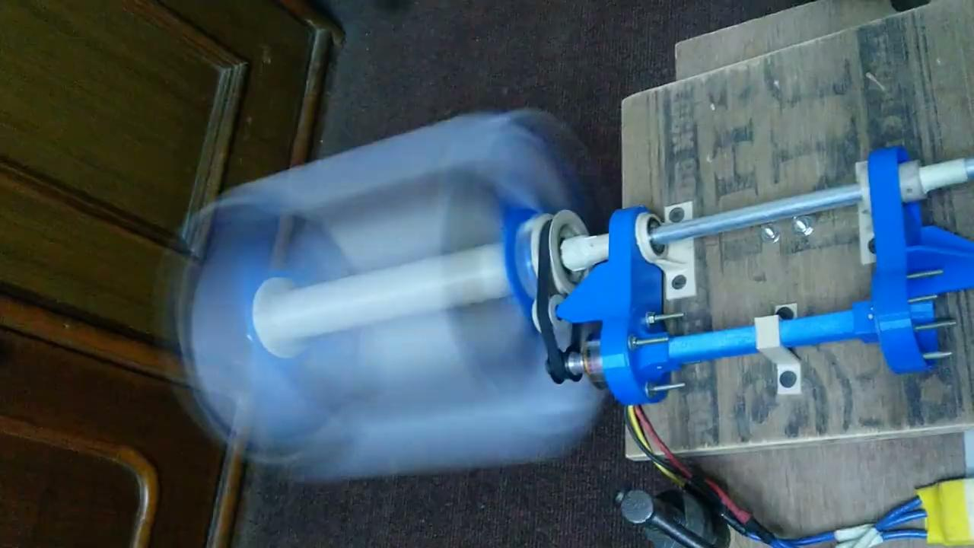
9. Experimental Test
FYP BME-075
Notes:
Thrust determination using Testing Rig Parts to be manufactured by 3D Printing URANS Solver ANSYS Fluent for CFD Simulation

Slide 26
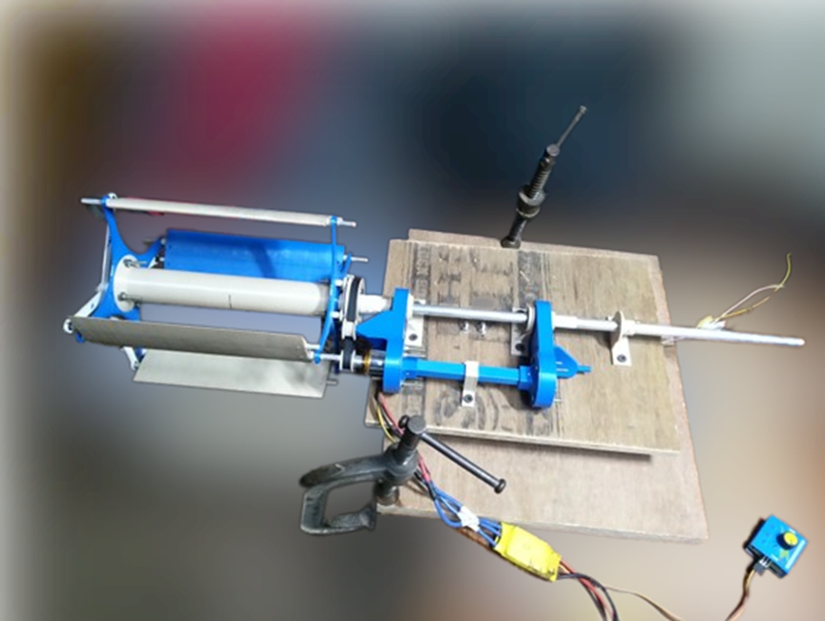
9. Experimental Test Setup
FYP BME-075
Notes:
Thrust determination using Testing Rig Parts to be manufactured by 3D Printing URANS Solver ANSYS Fluent for CFD Simulation

Slide 27
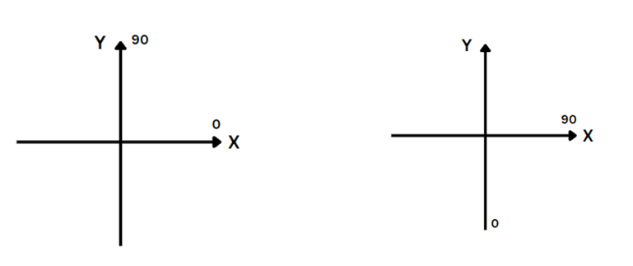
9. Experimental Test
Coordinate System
Coordinate System of the System (left) Coordinate System for Phase Angle (right)
FYP BME-075
Notes:
Thrust determination using Testing Rig Parts to be manufactured by 3D Printing URANS Solver ANSYS Fluent for CFD Simulation

Slide 28
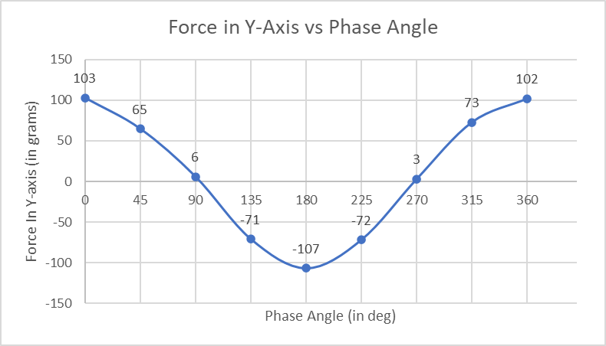
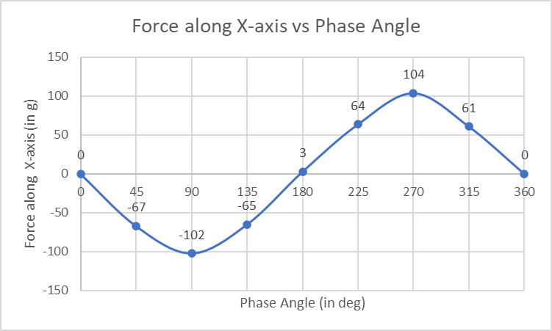
9. Experimental Test
Experimental Results
FYP BME-075
Notes:
Thrust determination using Testing Rig Parts to be manufactured by 3D Printing URANS Solver ANSYS Fluent for CFD Simulation

Slide 29
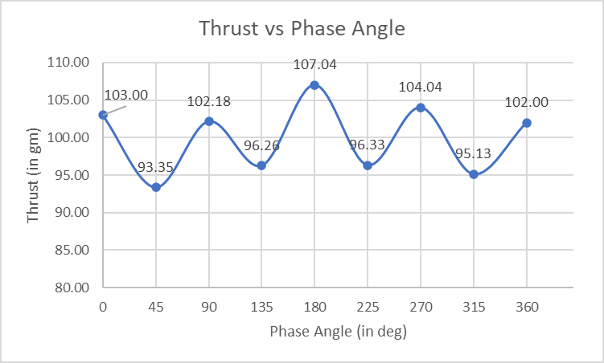
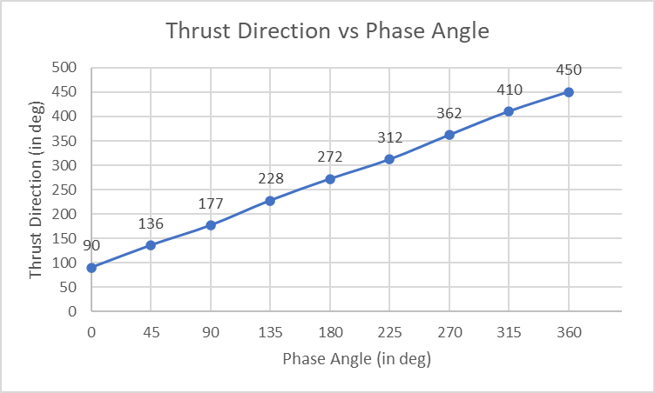
9. Experimental Test
Experimental Results
FYP BME-075
Notes:
Thrust determination using Testing Rig Parts to be manufactured by 3D Printing URANS Solver ANSYS Fluent for CFD Simulation

Slide 30
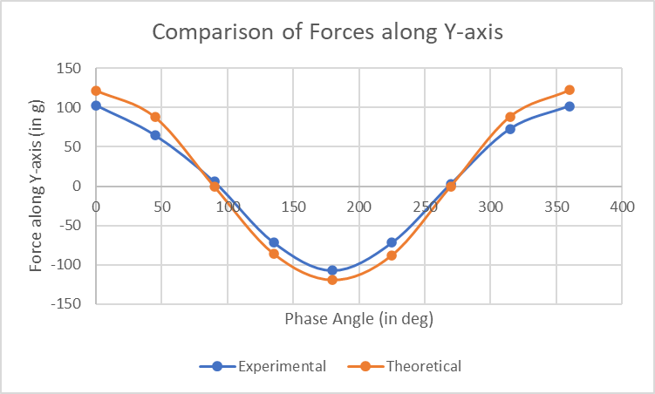
10. Conclusion
FYP BME-075
Notes:
Thrust determination using Testing Rig Parts to be manufactured by 3D Printing URANS Solver ANSYS Fluent for CFD Simulation

Slide 31
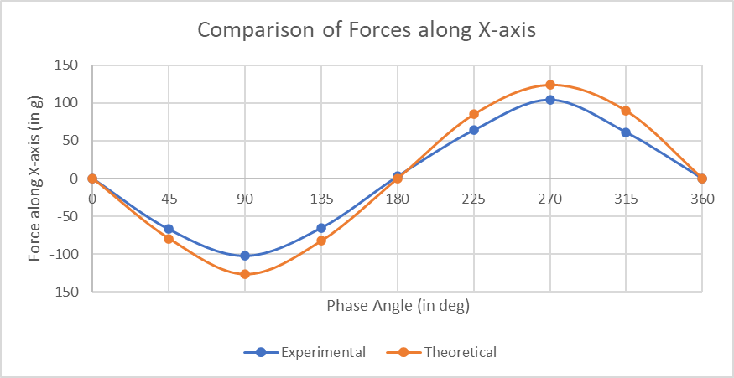
10. Conclusion
FYP BME-075
Notes:
Thrust determination using Testing Rig Parts to be manufactured by 3D Printing URANS Solver ANSYS Fluent for CFD Simulation

Slide 32
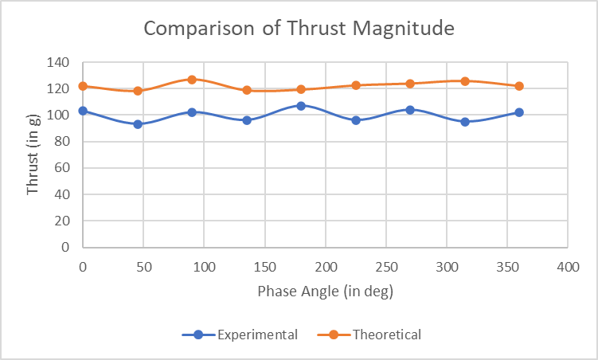
10. Conclusion
FYP BME-075
Notes:
Thrust determination using Testing Rig Parts to be manufactured by 3D Printing URANS Solver ANSYS Fluent for CFD Simulation

Slide 33
10. Conclusion
Thrust Vector Pattern
Experimental
Theoretical
FYP BME-075
Notes:
Thrust determination using Testing Rig Parts to be manufactured by 3D Printing URANS Solver ANSYS Fluent for CFD Simulation

Slide 34
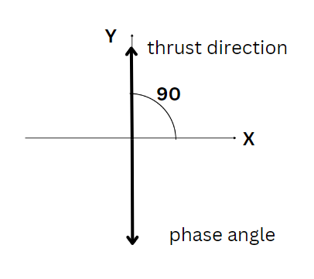
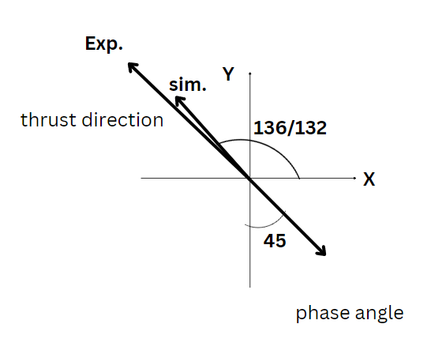

10. Conclusion
Thrust Vector Pattern
FYP BME-075
Notes:
Thrust determination using Testing Rig Parts to be manufactured by 3D Printing URANS Solver ANSYS Fluent for CFD Simulation

Slide 35



10. Conclusion
Thrust Vector Pattern
FYP BME-075
Notes:
Thrust determination using Testing Rig Parts to be manufactured by 3D Printing URANS Solver ANSYS Fluent for CFD Simulation

Slide 36


10. Conclusion
Thrust Vector Pattern
FYP BME-075
Notes:
Thrust determination using Testing Rig Parts to be manufactured by 3D Printing URANS Solver ANSYS Fluent for CFD Simulation

Slide 37
10. Conclusion
Direction of thrust is nearly opposite in direction to the phase angle.
FYP BME-075
Notes:
Thrust determination using Testing Rig Parts to be manufactured by 3D Printing URANS Solver ANSYS Fluent for CFD Simulation

Slide 38
11. Problems & Limitations
Problems Encountered
FYP BME-075
Failure of 3D printed parts
Specific design for each control rod required
Excessive vibration at natural frequency
Notes:
Thrust determination using Testing Rig Parts to be manufactured by 3D Printing URANS Solver ANSYS Fluent for CFD Simulation

Slide 39
11. Problems & Limitations
Limitations
FYP BME-075
Limited to ongoing research.
Validation of our result shall be done by comparing it with the results from simulation.
Conventional control mechanism
RPM limitation due to resonant vibration
Notes:
Thrust determination using Testing Rig Parts to be manufactured by 3D Printing URANS Solver ANSYS Fluent for CFD Simulation

Slide 40
12. References
FYP BME-075
Benedict, Moble, et al. "Development of a Quad Cycloidal-Rotor Unmanned Aerial Vehicle." Journal of the American Helicopter Society 61.2 (2016): 1-12.
Benedict, Moble, Inderjit Chopra and R. Gupta. "Design, Development and Open-Loop Flight-Testig of a Twin-Rotot Cyclocopter." Journal of the American Helicopter Society 58 (2013): 1-10. <https://doi.org/10.4050/jahs.58.042005.>.
Benedict, Moble, Tejaswi Jarugumilli and Inderjit Chopra. "Effect of Rotor Geometry and Blade Kinematics on Cycloidal Rotor Hover Performance." Journal of Aircraft 50 (2013): 1340-1352.
Bowers, Peter M. ROTOPLAN. 8 June 2013. web. 25 June 2022. <http://www.rotoplan.narod.ru/history_e.htm>.

Slide 41
12. References
FYP BME-075
Cogan, Shawn and Louis Gagnon. "Numerical Analysis of Cyclorotor Aerodynamic Properties in Hovering State." Material Science and Engineering Conference Series. 2022. 012039. <https://ui.adsabs.harvard.edu/abs/2022MS&E.1226a2039C>.
Gagno, Louis, Marco Morandini and Stephane Fournier. "Parametric Optimization of a Cyclogiro Aircraft Design for Efficient Hover with Aeroelastic Considerations." Journal of Applied and Computational Mechanics 7 (2021): 1774-1787.
Hrishikeshavan, Vikram, Moble Benedict and Inderjit Chopra. "Identification of Flight Dynamcis of a Cyclocopter Micro Air Vehicle in Hover." Journal of Aircraft 52 (2014).

Slide 42
12. References
FYP BME-075
Jarugumilli, Teja, Inderjit Chopra and Mable Benedict. "Experimental Optimization and Performance Analysis of a MAV Scale Cycloidal Rotor." 49th AIAA Aerospace Sciences Meeting Including the New Horizons Forum and Aerospace Exposition. American Institute of Aeronautics and Astronautics, 2011. 2011-821.
Lee, Ho Yong, Jai Sang Jung and In Seong Hwang. "A New VTOL UAV Cyclocopter with Cycloidal Blades System." American Helicopter Society; 60th annual forum proceedings. Baltimore: American Helicopter Society International, 2004. 1569-1586.
Leger, Jakson A, Jose C Pascoa and Carlos M Xisto. "Anaytical Modeling of a Cyclorotor in Hover State." Proceedings of the Institution of Mechanical Engineers, Part G: Journal of Aerospace Engineering. October: SAGE, 2015. 2163-2177.

Slide 43
12. References
FYP BME-075
Shrestha, Elena, et al. "Development of a Meo-Scale Cycloidal-Rotor Aircraft for Micro Air Vehicle Application." International Journal of Micro Air Vehicles 9.3 (2017): 218-231.
—. "Development of Control Strategies and Flight Testing of a Twing-Cyclocopter in Forward Flight." American Helicopter Society 70th Annual Forum. Montreal: American Helicopter Society International, 2014.
YUN, CHUL YONG, et al. "Thrust Control Mechaism of VTOL UAV Cyclocopter with Cycloidal Blades System." JOURNAL OF INTELLIGENT MATERIAL SYSTEMS AND STRUCTURES 16.11-12 (2005): 937-943.
The Cyclogyros: Planned Paddle-Wheel Aeroplanes, www.dself.dsl.pipex.com/museum/transport/cyclogyro/cyclogyro.htm, personal web page, retrieved 5-12-08, 2005.

Slide 44
12. References
FYP BME-075
Donners, L. (2022). Experimental validation of a cycloidal rotor URANS CFD model and geometric parameter optimization(Bachelor's thesis)..
Tobias Holzmann ,"OpenFOAM guide/The PIMPLE algorithm in OpenFOAM" https://openfoamwiki.net/index.php/OpenFOAM_guide/The_PIMPLE_algorithm_in_OpenFOAM
Simscale Team, “CFD:PIMPLE ALGORITHM” https://www.simscale.com/forum/t/cfd-pimple-algorithm/81418
Holzmann, T. (2016). Mathematics, numerics, derivations and OpenFOAM®. Loeben, Germany: Holzmann CFD.
Greenshields, C. J. (2018). OpenFOAM user guide Version 6. The OpenFOAM Foundation, 237, 624.

Slide 45
THANK YOU
FYP BME-075

